Slide 1
Campaign Data Analysis
June 30, 2024
Epsilon Data Science
Navya Bingi, Data Science Intern

Slide 2
Data Cleaning
Segment “Defectors’ were removed from the datasets
Variable counts that were too small and cluttered graphs were removed to focus on bigger proportions of variables

Slide 3
Dec 2022 - Jan 2023 Campaign

Slide 4
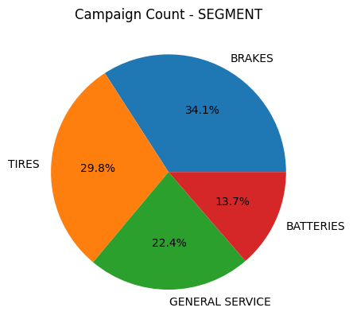
Campaign Count by Segment
Brake and tire campaigns were popular

Slide 5
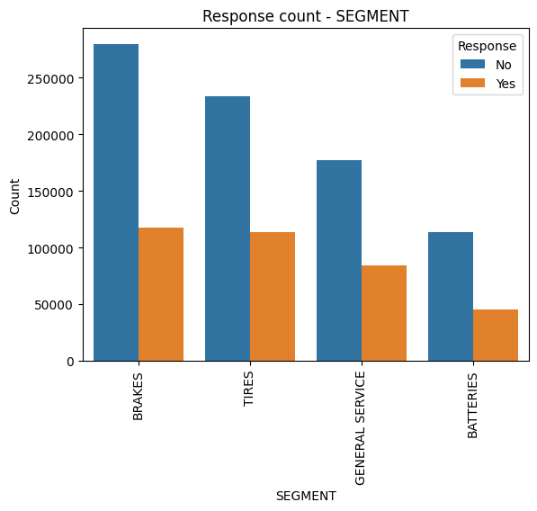
Response Count by Segment
Both brake and tire campaigns seem to receive a similar amount of attention from the customers
Popular coupons offered in brake campaigns that received a response: 15% OFF and 10% OFF

Slide 6
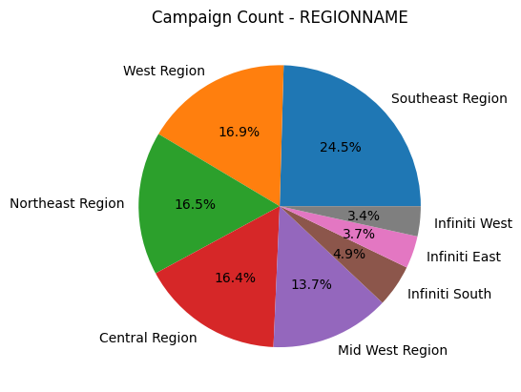
Campaign Count by Region
Most campaigns were sent to the Southeast Region

Slide 7
June 2023- July 2023 Campaign

Slide 8
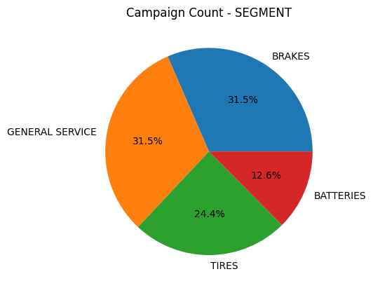
Campaign Count by Segment
Brake and general service campaigns were popular

Slide 9
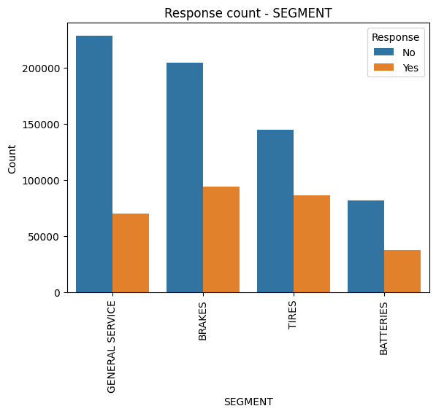
Response Count by Segment
Brake campaigns received the most responses, closely followed by tires.
Popular coupons offered in brake and general service campaigns that received a response: 15% OFF/10% OFF and $10/10% OFF respectively

Slide 10
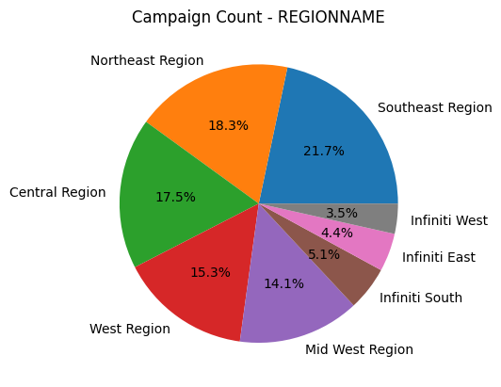
Campaign Count by Region
Most campaigns were sent to the Southeast Region

Slide 11
March 2023- April 2023 Campaign

Slide 12
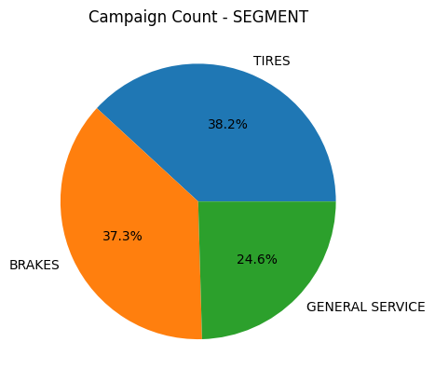
Campaign Count by Segment
Tire and break campaigns were popular

Slide 13
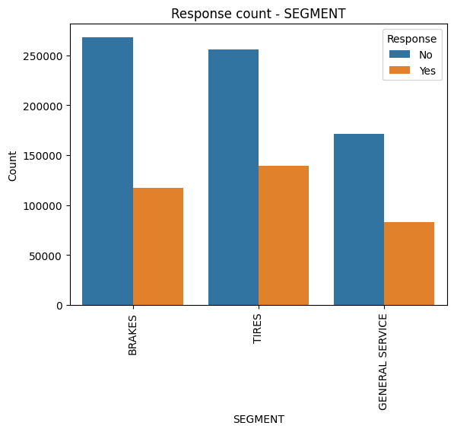
Response Count by Segment
Tire campaigns received the most responses, closely followed by brakes.
Popular coupons offered in brake and tire campaigns that received a response were 10% OFF, 15% OFF, 20% OFF

Slide 14
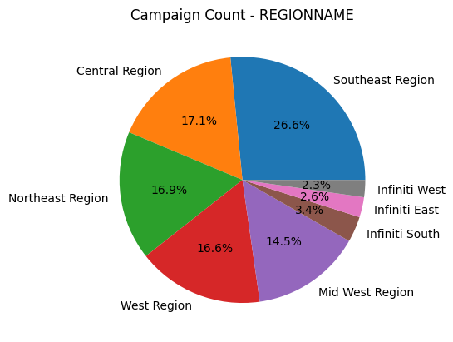
Campaign Count by Region
Most campaigns were sent to the Southeast Region

Slide 15
Sept. 2023- Oct. 2023 Campaign

Slide 16
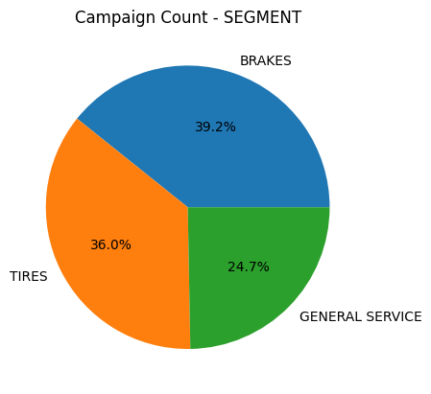
Campaign Count by Segment
Tire and break campaigns were popular

Slide 17
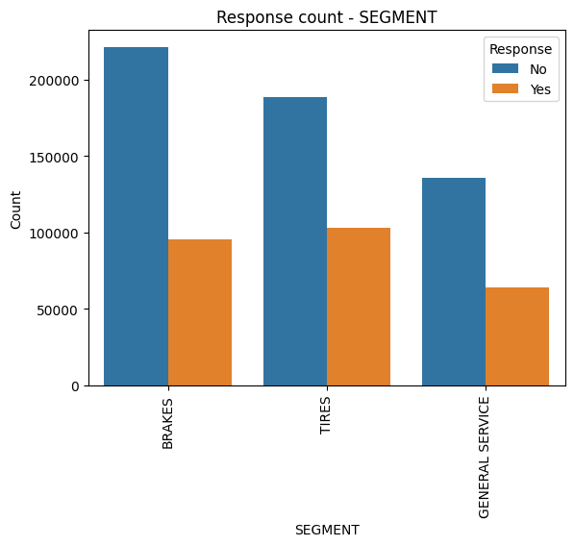
Response Count by Segment
Tire campaigns received the most responses, closely followed by brakes.
Popular coupons offered in brake and tire campaigns that received a response were 10% OFF and $10 OFF

Slide 18
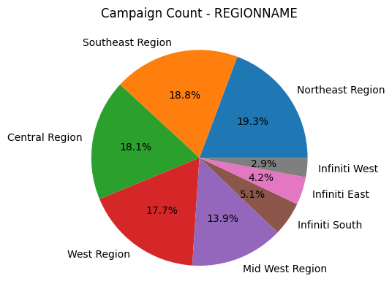
Campaign Count by Region
Most campaigns were sent to the Northeast and Southeast Region

Slide 19
Key Insights
Tire and Brake campaigns received the most attention from customers
Campaigns targeted the Southeast and Northeast regions more
Many coupon types were available, from %10 off to $400, but %10 OFF, 15% OFF, and $10 OFF were most popular
Newbies, brand loyalists, and measured services were targeted the most
Although certain dealerships sent out the most campaigns in the popular regions, these dealerships did not receive the most responses in those regions
Client should focus on: tire and brake campaigns, Southeast/Northeast regions, offer coupons with percentages, and target newbies and brand loyalists.

